Slide 1
FOOT HUB
By
Sri Ram
Jayakkavin

Slide 2
Objective
Foot Hub is an e-shopping application which mainly focusing on to sell the all type footwears products through online.
In this project, for frontend angular is used and for backend .net is use and for database SQL server is used.

Slide 3
User Flow
The user will directly landed to home page which consists of navigation link, via these link user can view the products.
In navigation bar user will select the category based on the category products will be display.
User can able to further filter the product based on the brand, size, etc.
If the user need to buy the product they will click the order now button and buy the product.

Slide 4
Table Details
Product_Master
p_id
o_id
c_id
t_id
p_name
size
price
disc
total_stock
Occasion
o_id
o_name
Product_Type
t_id
t_name
Brand
b_id
b_name

Slide 5
Table Details
Category_Type
c_id
c_name
User
u_id
u_name
U_email
U_password
u_phone
Order
order_id
u_id
address
prize
date
Order_Link
order_id
u_id
p_id
quantity

Slide 6

Screenshots

Slide 7
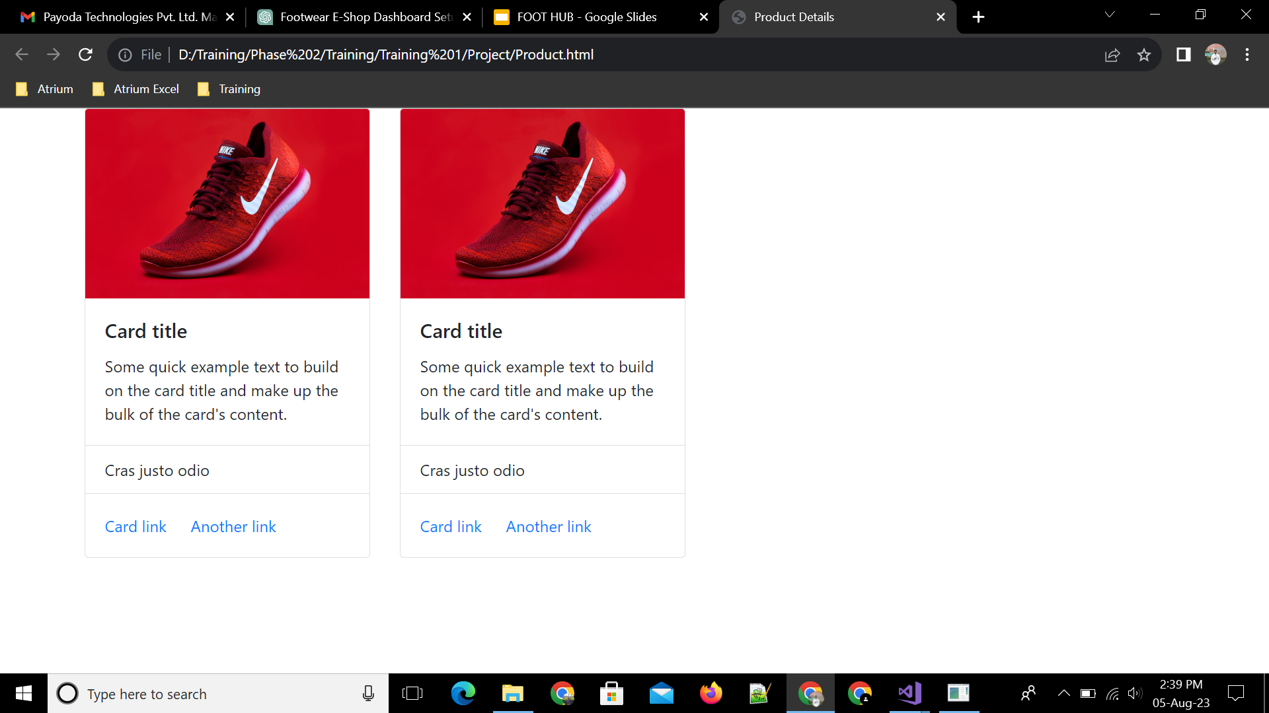
Screenshots

Slide 8
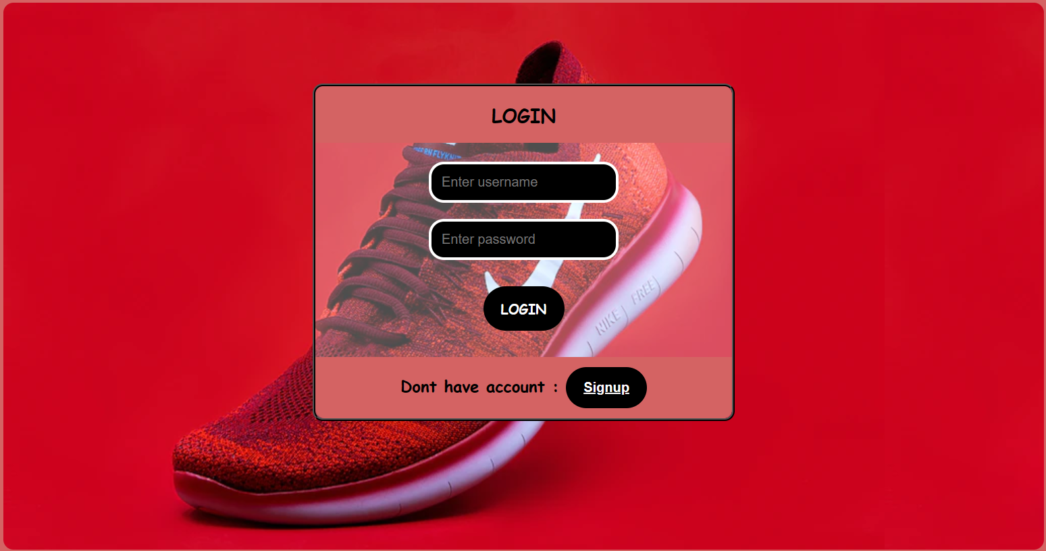
ScreenShots

Slide 9
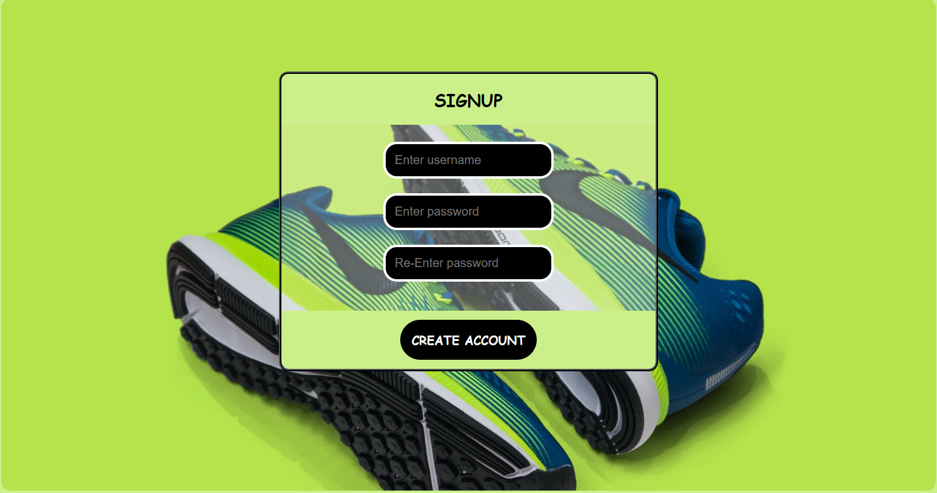
Screenshots

Slide 10
THANK YOU

